Slide 1
Foundations of Cryptography IND-m-EAV, IND-CPA, IND-m-CPA, arbitrary-length encryption
LiangFeng Zhang
zhanglf@shanghaitech.edu.cn
SIST, ShanghaiTech, 2019F

Slide 2


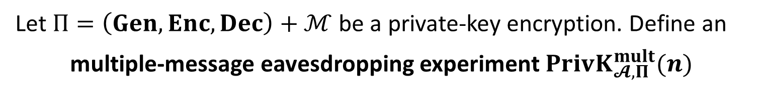



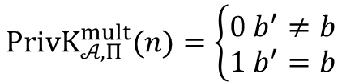


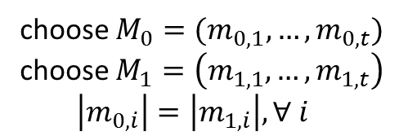

IND-m-EAV
Let $Π=\left(Gen, Enc, Dec\right)+ℳ$ be a private-key encryption. Define an
multiple-message eavesdropping experiment $PrivK_{𝓐, Π}^{mult}(n)$
choose $M_{0}=(m_{0,1},…,m_{0,t})$
choose $M_{1}=\left(m_{1,1},…,m_{1,t}\right)$
$\left|m_{0,i}\right|=\left|m_{1,i}\right|, ∀ i$
$$M_{0},M_{1}$$
$$k←Gen\left(1^{n}\right)$$
$$Challenger$$
$$b←\{0,1\}$$
$$Adversary 𝒜$$
$$c_{i}←Enc(k,m_{b,i})$$
$$C=(c_{1},…,c_{t})$$
$$b′$$
$$PrivK_{𝒜, Π}^{mult}(n)=\left\{\begin{aligned}0 b^{′}≠b \\ 1 b^{′}=b\end{aligned}\right.$$
$t$: can be any polynomial function in $n;$ chosen by the adversary

Slide 3
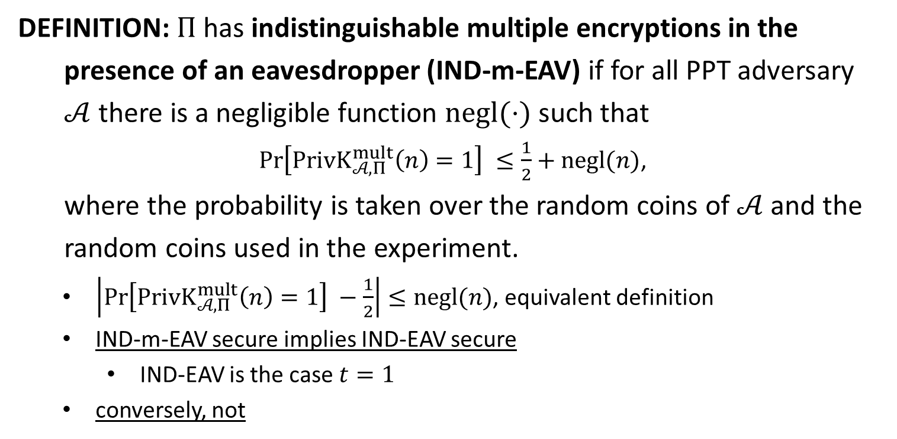
IND-m-EAV
DEFINITION: $Π$has indistinguishable multiple encryptions in the
presence of an eavesdropper (IND-m-EAV) if for all PPT adversary
$𝒜$ there is a negligible function $negl(⋅)$ such that
$\operatorname{Pr}\left[PrivK_{𝒜, Π}^{mult}\left(n\right)=1\right] ≤\frac{1}{2}+negl(n)$,
where the probability is taken over the random coins of $𝒜$ and the
random coins used in the experiment.
$\left|\operatorname{Pr}\left[PrivK_{𝒜, Π}^{mult}\left(n\right)=1\right] −\frac{1}{2}\right|≤negl(n)$, equivalent definition
IND-m-EAV secure implies IND-EAV secure
IND-EAV is the case $t=1$
conversely, not

Slide 4
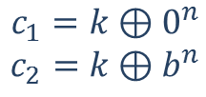

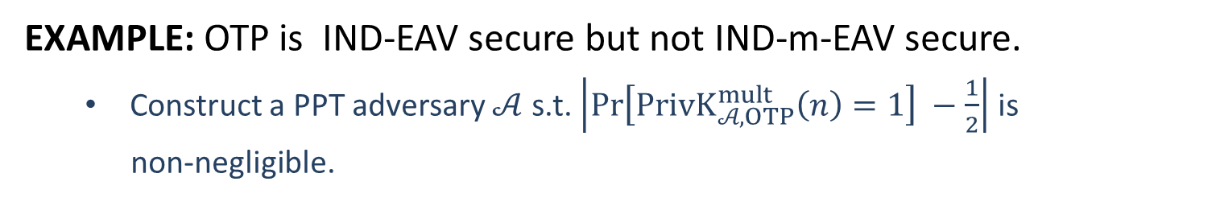






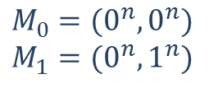

IND-m-EAV
EXAMPLE: OTP is IND-EAV secure but not IND-m-EAV secure.
Construct a PPT adversary $𝒜$ s.t. $\left|\operatorname{Pr}\left[PrivK_{𝒜, OTP}^{mult}\left(n\right)=1\right] −\frac{1}{2}\right|$ is
non-negligible.
$$M_{0}=(0^{n}, 0^{n})$$
$$M_{1}=(0^{n},1^{n})$$
$$M_{0},M_{1}$$
$$k←{\left\{0,1\right\}}^{n}$$
$$b←\{0,1\}$$
$$Challenger$$
$$Adversary 𝒜$$
$$c_{1}=k⊕0^{n}$$
$$c_{2}=k⊕b^{n}$$
$$C=(c_{1},c_{2})$$
$$b′$$
$$b^{′}=0 iff c_{1}=c_{2}$$

Slide 5
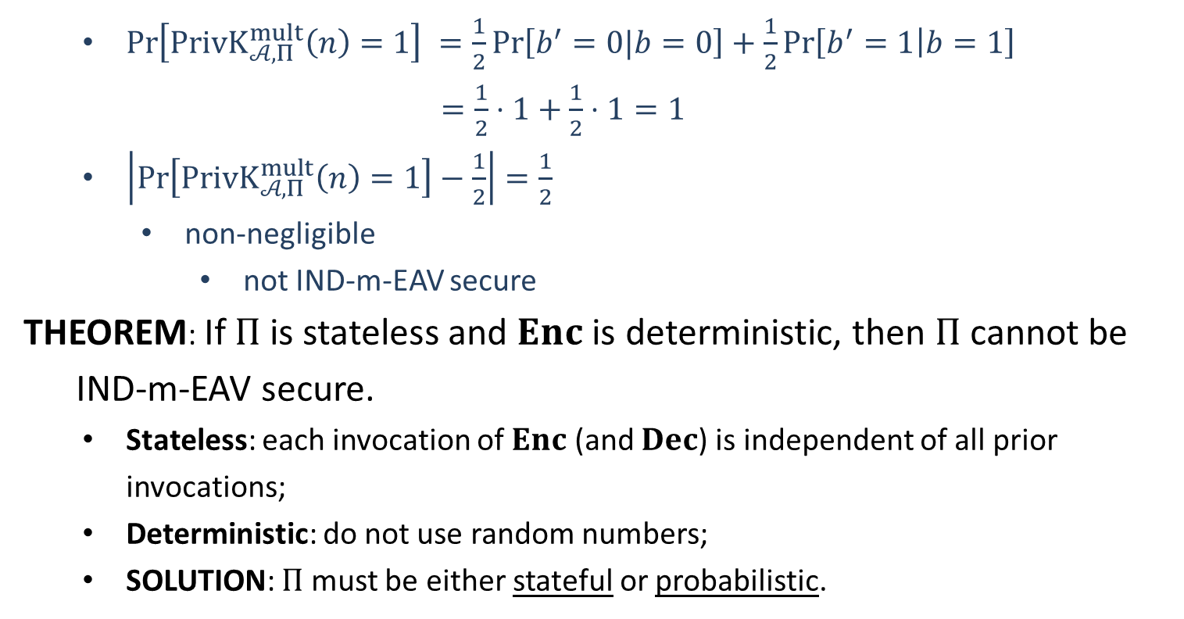
IND-m-EAV
$\operatorname{Pr}\left[PrivK_{𝒜, Π}^{mult}\left(n\right)=1\right] =\frac{1}{2}\operatorname{Pr}\left[b^{′}=0|b=0\right]+\frac{1}{2}\operatorname{Pr}\left[b^{′}=1 | b=1\right]$
$=\frac{1}{2}⋅1+\frac{1}{2}⋅1=1$
$\left|\operatorname{Pr}\left[PrivK_{𝒜, Π}^{mult}\left(n\right)=1\right]−\frac{1}{2}\right|=\frac{1}{2}$
non-negligible
not IND-m-EAV secure
THEOREM: If $Π$ is stateless and $Enc$ is deterministic, then $Π$ cannot be
IND-m-EAV secure.
Stateless: each invocation of $Enc$ (and $Dec$) is independent of all prior invocations;
Deterministic: do not use random numbers;
SOLUTION: $Π$ must be either stateful or probabilistic.

Slide 7












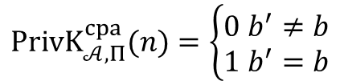
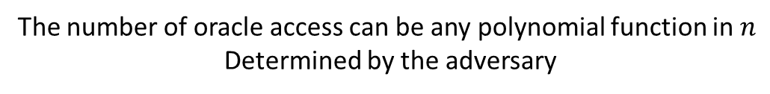
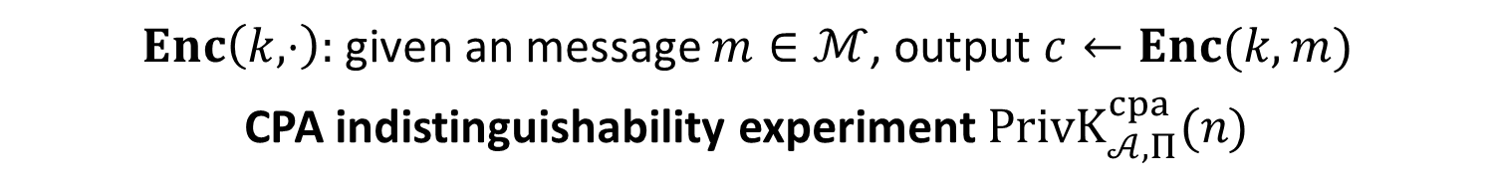


$$\text{Chosen}\text{−}\text{Plaintext} \text{Attack}$$
$Enc\left(k,⋅\right):$given an message $m∈ℳ$, output $c←Enc(k,m)$
CPA indistinguishability experiment $PrivK_{𝒜, Π}^{cpa}(n)$
$$k←Gen\left(1^{n}\right)$$
$$oracle access to$$
$$Enc\left(k,⋅\right)$$
$$m_{0},m_{1}$$
$$\left|m_{0}\right|=|m_{1}|$$
$$Challenger$$
$$b←\{0,1\}$$
$$Adversary 𝒜$$
$$c←Enc(k,m_{b})$$
$$c$$
$$oracle access to$$
$$Enc\left(k,⋅\right)$$
$$b′$$
$$PrivK_{𝒜, Π}^{cpa}(n)=\left\{\begin{aligned}0 b^{′}≠b \\ 1 b^{′}=b\end{aligned}\right.$$
The number of oracle access can be any polynomial function in $n$
Determined by the adversary

Slide 8
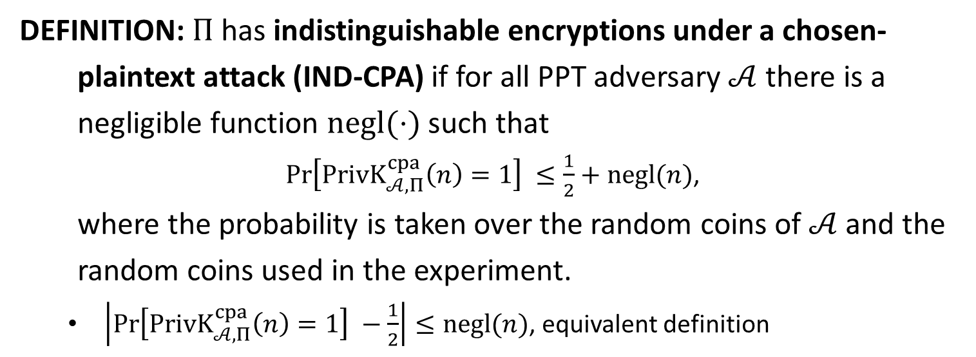
IND-CPA
DEFINITION: $Π$has indistinguishable encryptions under a chosen-
plaintext attack (IND-CPA) if for all PPT adversary $𝒜$ there is a
negligible function $negl(⋅)$ such that
$\operatorname{Pr}\left[PrivK_{𝒜, Π}^{cpa}\left(n\right)=1\right] ≤\frac{1}{2}+negl(n)$,
where the probability is taken over the random coins of $𝒜$ and the
random coins used in the experiment.
$\left|\operatorname{Pr}\left[PrivK_{𝒜, Π}^{cpa}\left(n\right)=1\right] −\frac{1}{2}\right|≤negl(n)$, equivalent definition

Slide 9


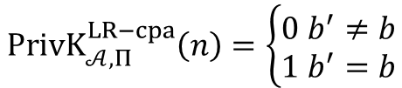
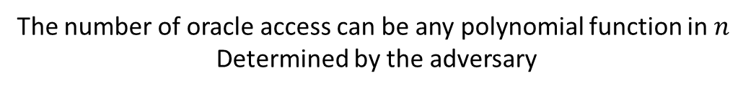






IND-m-CPA
$LR_{k,b}\left(⋅\right):$given $m_{0},m_{1}∈ℳ$, output $c←Enc(k,m_{b})$
LR-Oracle experiment $PrivK_{𝒜, Π}^{LR−cpa}(n)$
$$k←Gen\left(1^{n}\right)$$
$$b←\{0,1\}$$
$$oracle access to$$
$$LR_{k,b}(⋅)$$
$$Challenger$$
$$Adversary 𝒜$$
$$b′$$
$$PrivK_{𝒜, Π}^{LR−cpa}\left(n\right)=\left\{\begin{aligned}0 b^{′}≠b \\ 1 b^{′}=b\end{aligned}\right.$$
The number of oracle access can be any polynomial function in $n$
Determined by the adversary

Slide 10
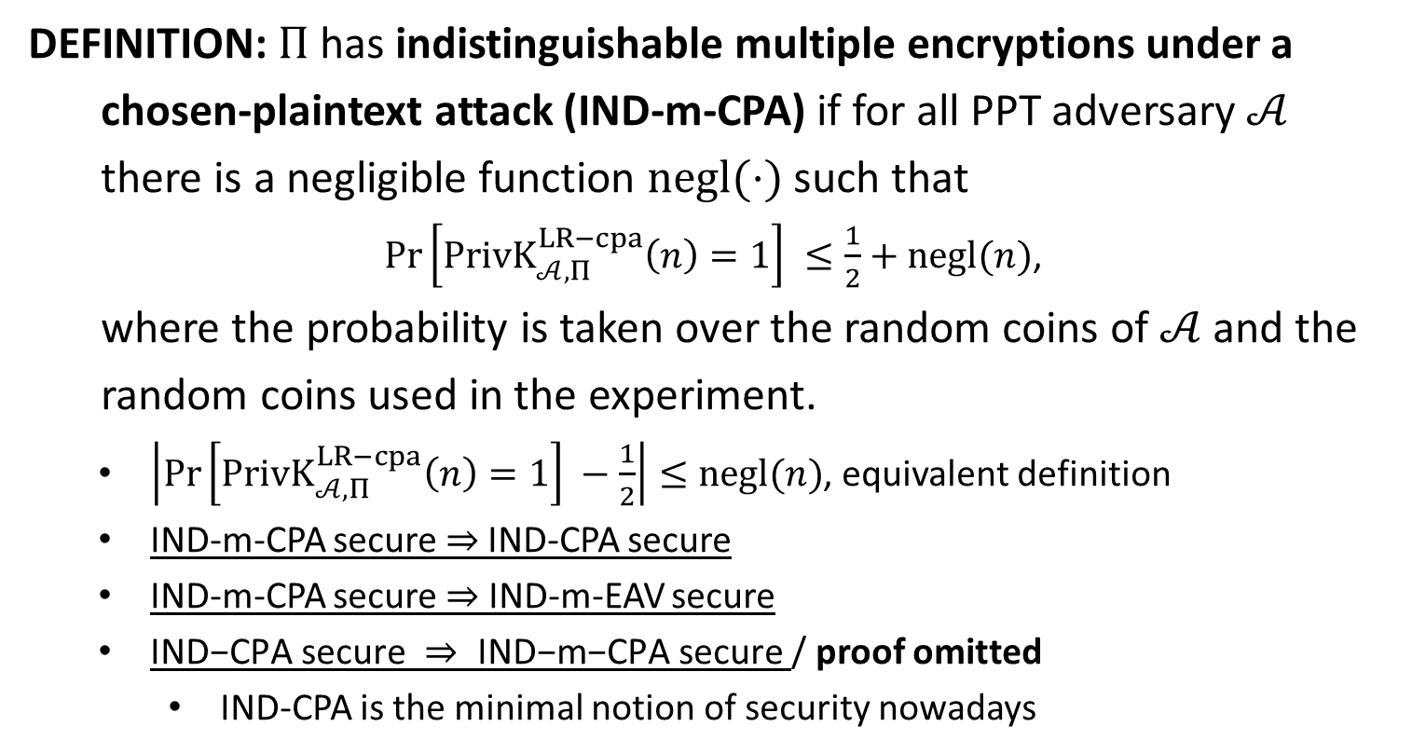
IND-m-CPA
DEFINITION: $Π$has indistinguishable multiple encryptions under a
chosen-plaintext attack (IND-m-CPA) if for all PPT adversary $𝒜$
there is a negligible function $negl(⋅)$ such that
$\operatorname{Pr}\left[PrivK_{𝒜, Π}^{LR−cpa}\left(n\right)=1\right] ≤\frac{1}{2}+negl(n)$,
where the probability is taken over the random coins of $𝒜$ and the
random coins used in the experiment.
$\left|\operatorname{Pr}\left[PrivK_{𝒜, Π}^{LR−cpa}\left(n\right)=1\right] −\frac{1}{2}\right|≤negl(n)$, equivalent definition
IND-m-CPA secure $⇒$IND-CPA secure
IND-m-CPA secure $⇒$ IND-m-EAV secure
$\text{IND}\text{−}\text{CPA} \text{secure} ⇒ \text{IND}\text{−}\text{m}\text{−}\text{CPA} \text{secure}$/ proof omitted
IND-CPA is the minimal notion of security nowadays

Slide 11













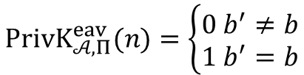




choose $M_{0}=(m_{0,1},…,m_{0,t})$
choose $M_{1}=\left(m_{1,1},…,m_{1,t}\right)$
$\left|m_{0,i}\right|=\left|m_{1,i}\right|, ∀ i$
IND-m-EAV
$$M_{0},M_{1}$$
$$k←Gen\left(1^{n}\right)$$
$$Challenger$$
$$b←\{0,1\}$$
$$Adversary 𝒜$$
$$c_{i}←Enc(k,m_{b,i})$$
$$C=(c_{1},…,c_{t})$$
$$b′$$
$$PrivK_{𝒜, Π}^{eav}(n)=\left\{\begin{aligned}0 b^{′}≠b \\ 1 b^{′}=b\end{aligned}\right.$$
IND-m-CPA
$$k←Gen\left(1^{n}\right)$$
$$b←\{0,1\}$$
$$oracle access to$$
$$LR_{k,b}(⋅)$$
IND-m-CPA is stronger than IND-m-EAV
$$Challenger$$
$$Adversary 𝒜$$
$$b′$$
$$PrivK_{𝒜, Π}^{LR−cpa}\left(n\right)=\left\{\begin{aligned}0 b^{′}≠b \\ 1 b^{′}=b\end{aligned}\right.$$

Slide 12









$$k←Gen\left(1^{n}\right)$$
IND-CPA
$$oracle access to$$
$$Enc\left(k,⋅\right)$$
$$m_{0},m_{1}$$
$$\left|m_{0}\right|=|m_{1}|$$
$$Challenger$$
$$b←\{0,1\}$$
$$Adversary 𝒜$$
$$c←Enc(k,m_{b})$$
$$c$$
$$oracle access to$$
$$Enc\left(k,⋅\right)$$
$$b′$$
$$PrivK_{𝒜, Π}^{cpa}(n)=\left\{\begin{aligned}0 b^{′}≠b \\ 1 b^{′}=b\end{aligned}\right.$$
IND-m-CPA
$$k←Gen\left(1^{n}\right)$$
$$b←\{0,1\}$$
$$orace access to$$
$$LR_{k,b}(⋅)$$
IND-m-CPA is stronger than IND-CPA
$$Challenger$$
$$Adversary 𝒜$$
$$b′$$
$$PrivK_{𝒜, Π}^{LR−cpa}\left(n\right)=\left\{\begin{aligned}0 b^{′}≠b \\ 1 b^{′}=b\end{aligned}\right.$$

Slide 14
Security Definitions
Perfect Secrecy
Perfect Indistinguishability
IND-EAV
IND-m-EAV
IND-CPA
IND-m-CPA

Slide 15
From Fixed-Length to Arbitrary-Length
CONSTRUCTION: $Π′=\left(Gen^{′}, Enc^{′}, Dec^{′}\right)+ℳ′$
Building Block: $Π=\left(Gen, Enc, Dec\right)+ℳ$ is IND-CPA secure.
$Gen^{′}\left(1^{n}\right):$ output $k←Gen(1^{n})$
$Enc^{′}\left(k,m\right):m=m_{1}m_{2}⋯m_{t}∈ℳ^{t}$
$c_{i}=Enc(k,m_{i})$ for every $i∈[t]$
output $c=c_{1}c_{2}⋯c_{t}$
$Dec^{′}(k,c)$
$m_{i}=Dec(k,c_{i})$
output $m=m_{1}m_{2}⋯m_{t}$
THEOREM: If $Π$ is IND-CPA secure, then $Π^{′}$ is also IND-CPA secure.
If $Π$ is IND-m-CPA secure, then $Π^{′}$ is also IND-m-CPA secure

Slide 16














From Fixed-Length to Arbitrary-Length
$$k←Gen\left(1^{n}\right)$$
$$b←\{0,1\}$$
$$orace access to$$
$$orace access to$$
$LR_{k,b}(⋅)$ in $Π′$
$LR_{k,b}(⋅)$ in $Π$
$$b′$$
$$b′$$
$$output 1 iff b^{′}=b$$
$$Challenger$$
IND-m-CPA $Π$
$$ℬ$$
IND-m-CPA $Π′$
$$𝒜$$
$$\operatorname{Pr}\left[PrivK_{ℬ, Π}^{LR−cpa}\left(n\right)=1\right] =\operatorname{Pr}\left[PrivK_{𝒜\text{,}Π^{′}}^{LR−cpa}\left(n\right)=1\right]$$

Slide 18
Pseudorandom Function (PRF)
DEFINITION: A keyed function is a two-input function
$F:{\left\{0,1\right\}}^{∗}×{\left\{0,1\right\}}^{∗}→{\left\{0,1\right\}}^{∗}$, where the first input $k$ is called key
notation: $F_{k}\left(x\right)=F\left(k,x\right)$
$F$ is efficient if there exists DPT algorithm computing $F(k,x)$
define $l_{key}, l_{in}, l_{out}$ such that $∀ k∈{\left\{0,1\right\}}^{l_{key}}, x∈{\left\{0,1\right\}}^{l_{in}}, F_{k}\left(x\right)∈{\left\{0,1\right\}}^{l_{out}}$
length-preserving: $l_{key}\left(n\right)=l_{in}\left(n\right)=l_{out}\left(n\right)=n$
DEFINITION: Let $F$ be a length preserving keyed function. For every $n$,
$F$ induces a distribution $F_{k}$ over $Func_{n}=\left\{f\right|f:{\left\{0,1\right\}}^{n}→{\left\{0,1\right\}}^{n}\}$,
the set of all functions that map $n$-bit input to $n$-bit output:
$choose k←{\left\{0,1\right\}}^{n} uniformly and at random$, $output F_{k}$
Truly Random Function: $f←Func_{n}$
PRF (informal): $F$ is said to be pseudorandom if $\{F_{k}\}$ and $\{f\}$ are
computationally indistinguishable.

